Slide 1

Aspect-oriented programming
Yan Cui
@theburningmonk
http://theburningmonk.com

Slide 2

Developer @ GameSys
Founded in 2001
#1 in the UK
Handle $5 Billion in turnover annually
First company to launch real money gaming on Facebook
Employ 1000 globally

Slide 3
Social Gaming @ GameSys
1 Million daily active users
250 Million requests/day
2 TB of analytics data/month
100% Cloud hosted (AWS + Google)
NoSQL Databases

Slide 4
Overview
Cross-Cutting Concerns
AOP
What’s in it for you
AOP
Terminologies
AOP and OOP
Solutions
Q&A

Slide 5
Cross-Cutting Concerns
The PROBLEM…

Slide 6

Cross-Cutting Concerns
Image by Mike Rohde
Notes:
Definition:
A Cross-Cutting Concern is a concern your application needs to address that is unrelated to your application’s problem domain, and ‘cuts across’ other concerns.
Examples:
Typically non-functional requirements such as tracing, logging, persistence, transaction control, security, error handling
Cross-cutting concerns are usually difficult to decompose from the rest of the system and results in:
tangled code, concerns are interwoven with each other in a module
scattered code, concerns are dispersed over many modules
high coupling
Addressing cross-cutting concerns usually means adding boilerplate code to your application, increasing both the size and complexity of your code, and the blast radius of any change that are not related to the problem domain, e.g. changing the persistence media.

Slide 7
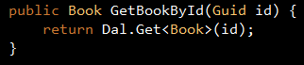


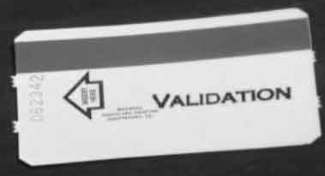
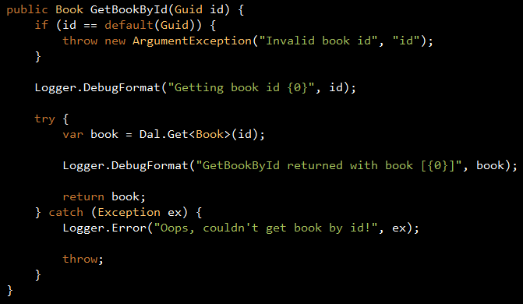
Function
Requirements
Non-Functional
Requirements
Production
Code
+
=

Slide 8
Cuts across multiple abstractions
Difficult to decompose
High-coupling
Boilerplate code
Notes:
Definition:
A Cross-Cutting Concern is a concern your application needs to address that is unrelated to your application’s problem domain, and ‘cuts across’ other concerns.
Examples:
Typically non-functional requirements such as tracing, logging, persistence, transaction control, security, error handling
Cross-cutting concerns are usually difficult to decompose from the rest of the system and results in:
tangled code, concerns are interwoven with each other in a module
scattered code, concerns are dispersed over many modules
high coupling
Addressing cross-cutting concerns usually means adding boilerplate code to your application, increasing both the size and complexity of your code, and the blast radius of any change that are not related to the problem domain, e.g. changing the persistence media.

Slide 9
Code tangling and scattering
Poor traceability
Lower productivity
Less code reuse
Harder refactoring
Notes:
Poor traceability – multiple concerns in the same module breaks linkage between requirement and its implementation, making it harder to understand what a piece of code is doing to address the problem domain.
Lower productivity – developers are spending too much time and attention to peripheral issues rather than the problem domain.
Less code reuse – boilerplate code propagated through cut and paste… no code reuse here!
Harder refactoring – changing requirements means touching many modules for a single concern.

Slide 10
Aspect-Oriented Programming
The SOLUTION…
Notes:
Which finally brings us to aspect oriented programming, and I’ll give you a second to read this quick definition from Wikipedia.

Slide 11
“AOP is a programming paradigm which aims to increase modularity by allowing the separation of cross-cutting concerns”
- wikipedia

Slide 12


Coding is HARD
AOP makes it EASY

Slide 13
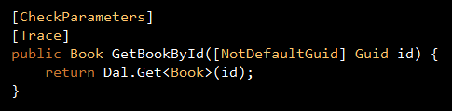
AOP
AOP
AOP
AOP
AOP
AOP
AOP
Notes:
Take the ‘GetBookById’ method we ended up with earlier, now let’s give ourselves a magic hat and let the hat devour that ugly piece of code, and with a touch of AOP magic we’ll get back a cleaner, more elegant and readable version of the ‘GetBookById’ method.
Under the hood, the two versions are the same, both log when they enter and exit the method, and both log any exceptions, also both versions of the code perform validation against the ‘id’ parameter to make sure that it’s not a default Guid.

Slide 14
AOP

Slide 15
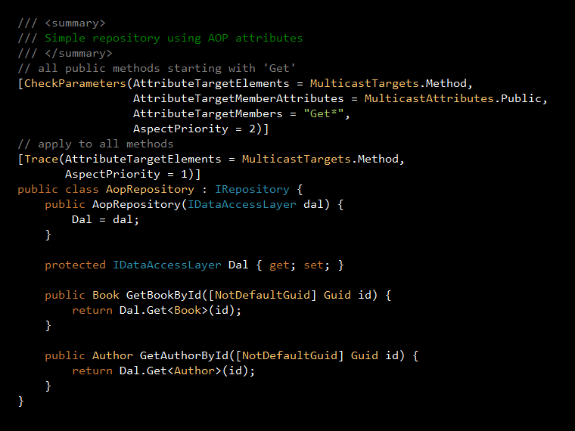
Notes:
Whist this is useful, it will still cause a lot of clutter when you have to apply the same set of attributes to many methods.
But worry not, another feature of AOP is the ability to multicast the same aspects into many places in your code, this feature is called Point Cut.

Slide 16
Centralize concerns implementation
Intercept method calls
Inject new behaviour
More reusable code
Cleaner code
Notes:
To summarize, AOP allows you to centralize your implementation of cross-cutting concerns.
It gives you a nice framework to intercept method calls and inject new behaviour with little change to your code.
Once you’ve modularized your code that deal with the cross-cutting concerns, you are able to reuse them in other projects.
This lets you write more reusable code and cleaner code.

Slide 17

What’s in it for YOU?
Notes:
That’s all very nice, but why should you care about writing reusable and clean code?
What do you get out of it?

Slide 18
Write less code
Read less code
More concise and easy to understand
More maintainable
Notes:
Well, for one, you end up writing less code, and therefore you will need to read less code too.
The code that you end up reading will be more concise and easy to understand as they’re no longer convoluted by cross-cutting concerns.
As you reduce the complexity of your code, it becomes more maintainable too.

Slide 19
Fewer code =
Less boilerplate code
More interesting work
Increased attention
More PRODUCTIVITY!
FEWER DEFECTS!
Notes:
Writing fewer lines of code means less chance for us to get it wrong, and therefore fewer defects in our code.
You have to less boilerplate code, and that makes your work more interesting, and therefore you pay more attention to what you do.
So all and all, you get a healthy boost of productivity when you take advantage of what AOP has to offer!

Slide 20
AOP
Diving a little deeper…
Notes:
Now that you have a rough idea of what AOP is and how it can help you, let me help you get a sense of how you go about using it in practice.
Before we do, let me give you a 2-minute crush course on the terminologies used in AOP.

Slide 21
Join Point
Place where behaviour can be added
Advice
Code that can be injected at join points
Point cut
Join points where advice should be applied
Aspect
Container holding point cuts and advice
Weaving
Combines advices with point cuts
Notes:
Join points are places in your code where an aspect can be inserted, for example, before and after a method call, when a method excepts, or when field or property is being accessed.
An advice is a piece of code that can be injected at join points to add new behaviour.
This is the boilerplate that you had taken out from your code so that you can encapsulate it into an aspect and then inject it in whilst keeping your code pretty.
A point cut is a set of join points where an advice can be applied.
It can be attribute drive, like the earlier example of ‘GetBookById’ method where we applied the two attributes to the method.
Or it can be filter driven, like the second example where we applied the attributes to the class instead and targeted methods that met our criteria.
When a point cut is matched, advice can be executed.
An aspect contains point cuts and advice, it is to AOP what class is to OOP, whereas classes holds methods and properties, aspects holds point cuts and advice.
Weaving is the process of taking the advice and injecting them into the point cuts in the core component and compose the final result.

Slide 22
AOP is complementary to OOP
AOP targets a specific problem
Code modularization
OOP – Real world objects
AOP – Functionalities
Notes:
AOP and OOP are not mutually exclusive; AOP is in fact complimentary to OOP and help you become a better OOP developer by helping you enforce some important design principles of OOP.
Unlike OOP, functional programming or declarative programming, which are general purpose paradigms aimed to solve most of the programming problems we face, and all competing to be the core paradigm of a language.
AOP on the other hand, is a paradigm which attempts to solve one very specific problem.
AOP and OOP both encourage code modularization and encapsulation, which leads to better code reusability and maintainability.
The difference between the two paradigms come in the form of WHAT they modularize on:
- OOP modularizes on basis of real world entities
AOP modularizes on basis of functionalities

Slide 23
Help you S.O.L.I.Dify your code
Single responsibility
Open/close
Notes:
For those of you who aren’t familiar with the SOLID principles, they stand for:
Single responsibility principle: an object should have only one responsibility
Open/Close principle: objects should be open for extension, but closed for modification
Liskov substitution principle: objects should be replaceable with instances of their subtypes without altering the correctness of that program
Interface segregation principle: many specific interfaces are better than one general purpose interface
Dependency inversion principle: one should depend upon abstraction rather than implementations
These are 5 principles that can help you create more maintainable software with fewer defects. Most of you should be familiar with the dependency inversion principle already because that’s the problem that IoC frameworks solve and IoC frameworks are extremely popular nowadays.
You can use AOP to help you better adhere to these principles, for instance, by using AOP to remove the cross-cutting concerns from your core program it becomes easier for you to follow the single responsibility principle.
Similarly, using point cut and multicast attribute as I demonstrated earlier, you are able to inject new behaviour into existing classes without modifying them, hence not breaking the open/close principle.

Slide 24
You can do AOP via:
Dynamic Proxies
Functional Programming
Code Generation
Dynamic Languages
Static Weaving
Notes:
So hopefully that’s sufficient evidence for you to want to give AOP a go, but in terms of actually start doing some aspect-oriented programming you have quite a number of different options, including:
Dynamic proxies with IoC frameworks
- Functional programming using higher-order functions
- Code generation using tools like T4
- Dynamic languages using their meta-programming capabilities
- Static weaving, by modifying the MSIL in a post-compilation process

Slide 25
Dynamic Proxies
AOP via...

Slide 26
IoC framesworks (Castle, Spring.Net)
Dynamic interceptors
Notes:
Dynamic proxies are supported in IoC frameworks such as Castle or Spring.net, and here’s a simple example of a logging interceptor that logs the entry and exit of a method and any unhandled exceptions that bubbles out of the method.

Slide 27
Dynamic Proxies

Slide 28
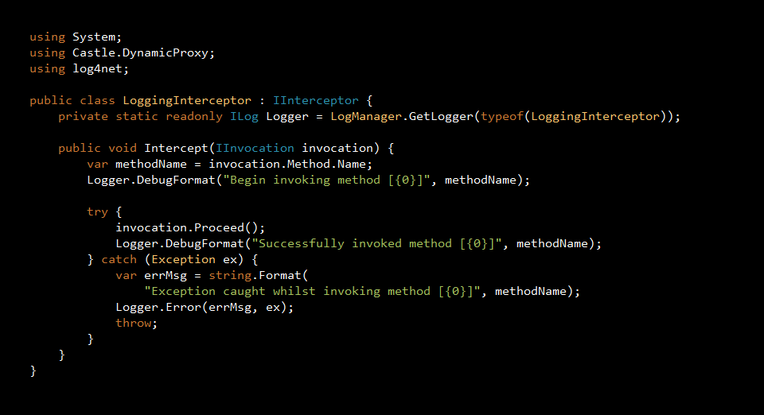

Slide 29
Advantages
Can use existing DI framework
Some frameworks provides built-in aspects
Aspects can be configured after build
Notes:
If you are using a dependency injection framework already, and all you want is to be able to intercept method calls and inject additional behaviour, then dynamic proxies represent the easiest way for you to adopt AOP in your project right away.
Also, some frameworks provide built-in aspects such as the logging aspect I showed you earlier.
Most such frameworks also allow you to configure aspects through configuration files, making it easier for you to make changes in a live environment without having to compile and deploy any code changes.

Slide 30
Disadvantages
Significant change to base code required to adapt
Limited AOP features
Do not work on static, non-public methods
Do not work on fields, properties, or events
Higher run-time overhead
No build-time verification
Objects must be instantiated using the container
Notes:
However, dynamic proxies only offer a limit set of AOP’s features, and if you’re not already using a dependency injection framework, adopting it into an existing code base will require a significant amount of work and change.
There are also a number of restrictions, dynamic proxies do not work on static, or non-public methods, and they do not work on fields, properties or events.
Since aspects are applied at runtime, there is a higher runtime overhead than there is with build-time AOP frameworks.
However, this is only likely to cause a noticeable impact on your application’s performance if you’re generating large numbers of dynamic proxies.
The bigger drawback is the lack of build-time verification to make sure that you’re using the aspects incorrectly.
But for me, the biggest problem with using dynamic proxies is that it only works if your objects are instantiated using the container.
This can cause major confusion to the consumers of your code, because when they instantiate the instances themselves the injected behaviours will not be present.
That is not always clear, and without looking into your code and your container configuration it’ll be difficult to figure which behaviours were injected and which weren’t.
This is one area where hard-to-detect bugs can creep in and you won’t see it until things blow up at runtime! Nasty stuff!

Slide 31

NOOOO Sir!!
Class, is AOP the same as Dependency Injection?
Notes:
Because IoC frameworks are so commonly used these days, and a lot people have their first experience with AOP through the use of dynamic proxies, many people have associated dependency injection with AOP.
Well, I’m here to tell you that the two are not the same, at all!
Dependency injection is a design pattern that addresses the problem of writing loosely-coupled components together, and helps you enforce the practice of design by contract.
You program to an abstraction/interface rather than an implementation, and instead rely on the container to provide the concrete implementation at runtime.
AOP on the other hand, addresses a very different issue: cross-cutting concerns as I showcased earlier.
Dependency injection became associated with AOP because it just happens to be in a convenient place to allow users to inject new behaviours to existing code base transparently.

Slide 32
Functional Programming
AOP via...

Slide 33
Functional Programming

Slide 34
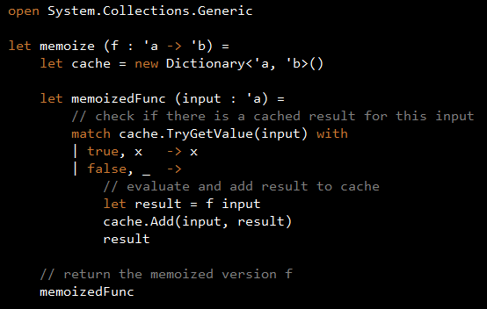
Notes:
That is the essence of the memoization technique, which I’ll show you right here with this bit of F# code. Don’t worry about the syntax; the important thing to note here is that this function takes another function as input, and use a dictionary to cache results before returning a modified version of the original function.
…DEMO…
The memoize function is simple and yet effective, however, it breaks down when you use it with a recursive function. It’s not hard to fix it, but the whole AOP experience here is just not quite transparent and unobtrusive as you’d like.

Slide 35
Advantages
No external dependencies
Notes:
The advantage of doing AOP in functional programming is that you don’t require any external dependencies as you do with dynamic proxies and static weaving, instead you write everything as higher-order functions in the language you’re already familiar with.

Slide 36
Disadvantages
Requires modification to every function
No support for matching rules
Manual aspect composition
Notes:
But, as I have demonstrated with recursive function, if you want to use the memoized version of the function f everywhere in your code, you’ll need to modify all the places where f is being used.
Also, there’s no support for matching rules that lets you apply the same aspect to multiple functions in bulk. And when you want compose different aspects together, i.e. combining multiple higher-order functions, you’ll need to do it manually which is a task that’s easier said than done.

Slide 37
Code Generation
AOP via…

Slide 38
T4, CodeSmith Tools

Slide 39
Advantages
Easy to generate complex source code

Slide 40
Disadvantages
Input is usually XML
Cannot inject new behaviour to existing code

Slide 41
Dynamic Languages
AOP via…

Slide 42
Dynamic Languages

Slide 43
Advantages
Meta-programming is easy

Slide 44
Disadvantages
Switching to a dynamic language can be scary
No (limited) Visual Studio tooling

Slide 45
Static Weaving
AOP via…

Slide 46
PostSharp, AspectJ
Uses low-level MSIL transformation
Compile time

Slide 47
Requirements
Aspect Decomposition
Aspects
Core program
Aspect Recomposition
Final System

Slide 48
Aspectual Decomposition
Identify primary and cross-cutting concerns
Concern Implementation
Implement concerns separately
Primary concern as Core Component using OO
Cross-cutting concerns as aspect
Aspectual Recomposition
Aspect weaver to weave the separately implemented code into a final system
Notes:
A static weaving solution AOP usually involve a three phase implementation:
Aspectual decomposition – based on requirements, identify concerns as either primary (problem domain) and cross-cutting
Concern implementation – code each concern separately, primary (OO) and cross-cutting (AO)
Aspectual recomposition – use aspect weaver to weave the separately implemented code together into a final system

Slide 49
PostSharp

Slide 50
Advantages
Most complete support of AOP features
Aspect usage is verified at build time
Better runtime performance

Slide 51
Disadvantages
Increased build time
New to many developers

Slide 52


Thank You!
Yan Cui
@theburningmonk

Slide 53
Q&A

